Slide 1
Chapter 25

Slide 2
Objectives

Slide 3
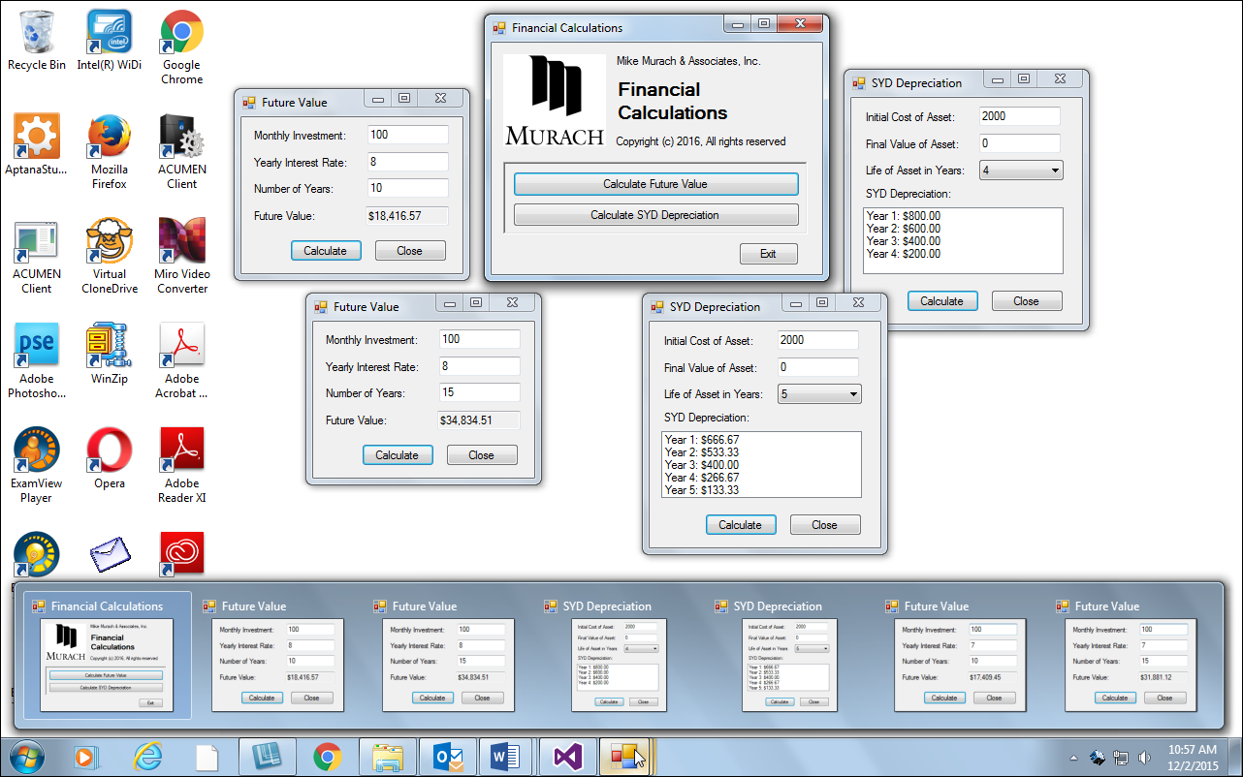
Single-document interface (SDI)

Slide 4
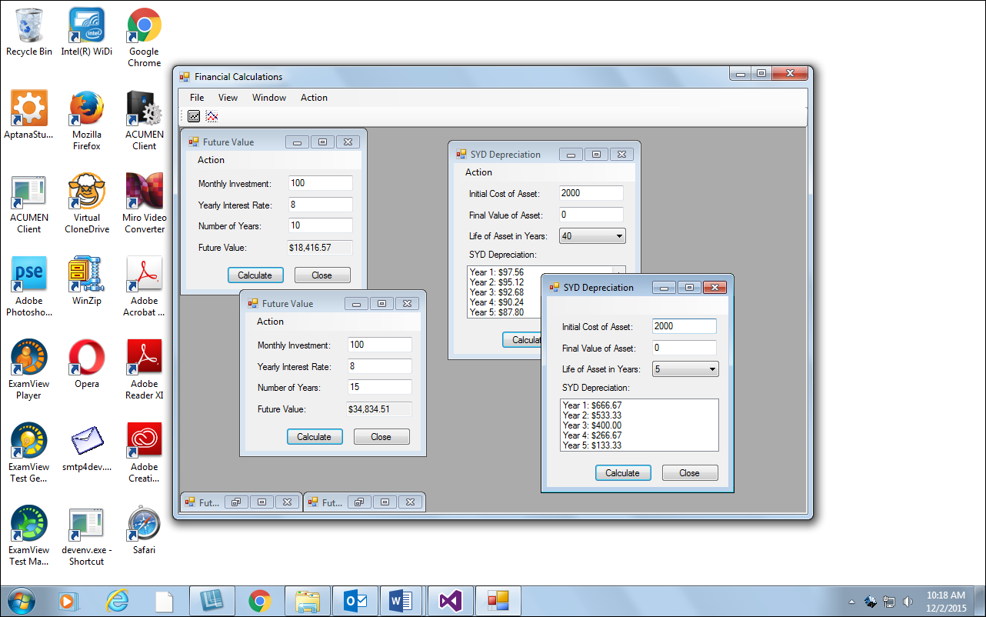
Multiple-document interface (MDI)

Slide 5
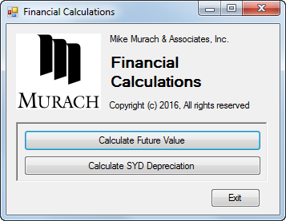
A startup form for the Financial Calculations application

Slide 6
Code that displays a new instance of a form

Slide 7
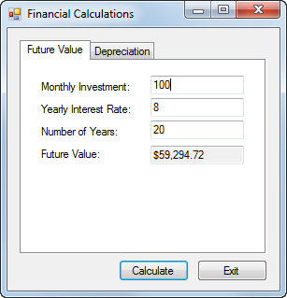
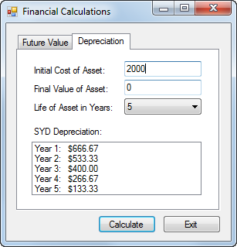
A form that uses a Tab control with two tabs

Slide 8
Code that uses the SelectedIndex property of the Tab control

Slide 9
Code that uses the SelectedIndexChanged event of the Tab control

Slide 10
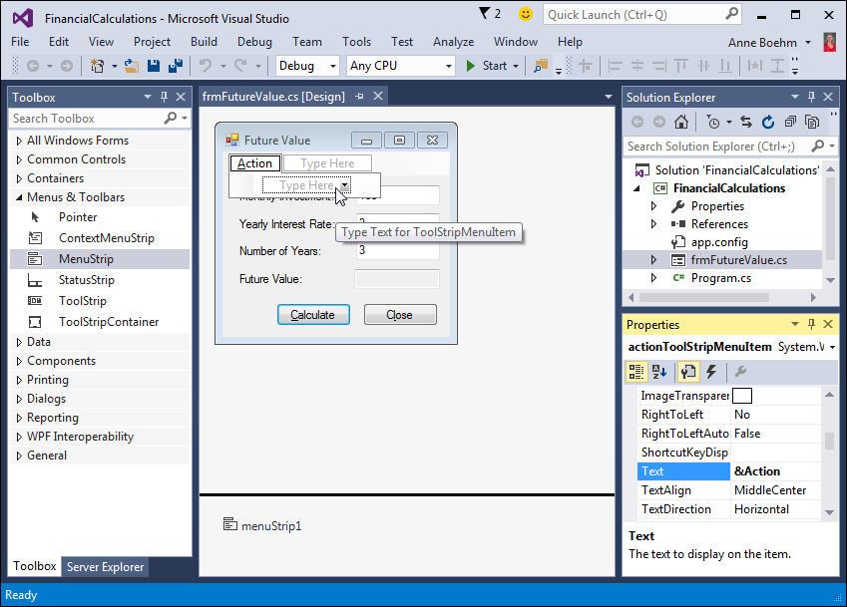
The start of the menu for the Future Value form

Slide 11
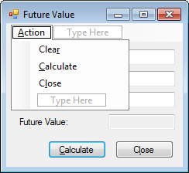
The complete Action menu

Slide 12
Common menu item properties

Slide 13
Code for a menu item that clears four controls

Slide 14
Code for a menu item that calls another event handler

Slide 15
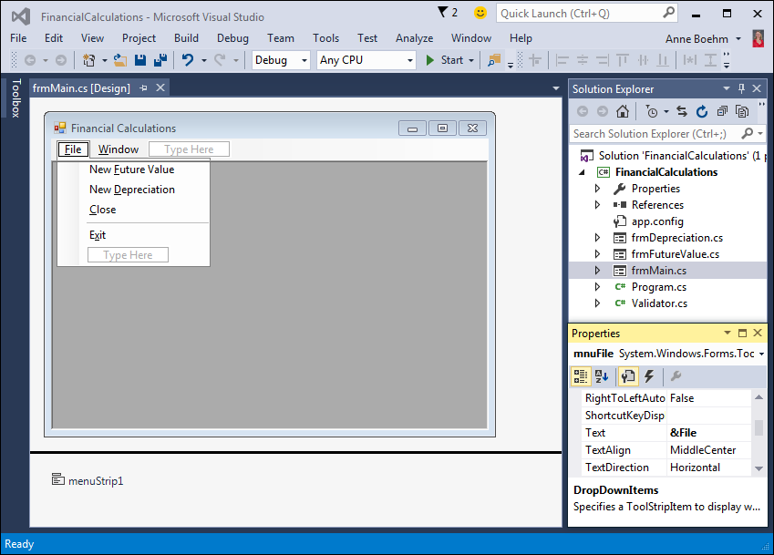
A project with one parent and two child forms

Slide 16
Properties and methods for a parent form

Slide 17
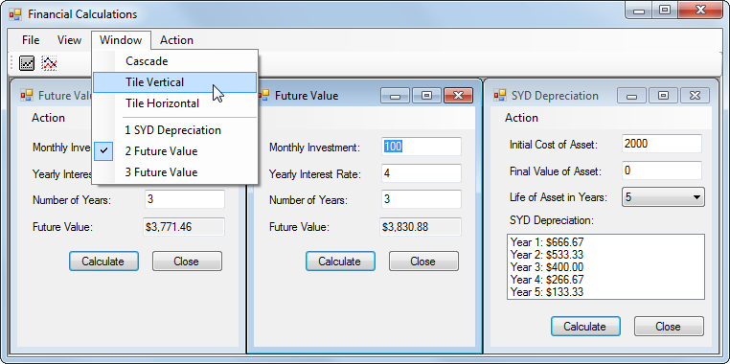
An MDI application with three child forms arranged vertically

Slide 18
Code that creates and displays a new instance of a child form

Slide 19
Code that arranges the child forms vertically

Slide 20
A ToolStrip with the standard items

Slide 21
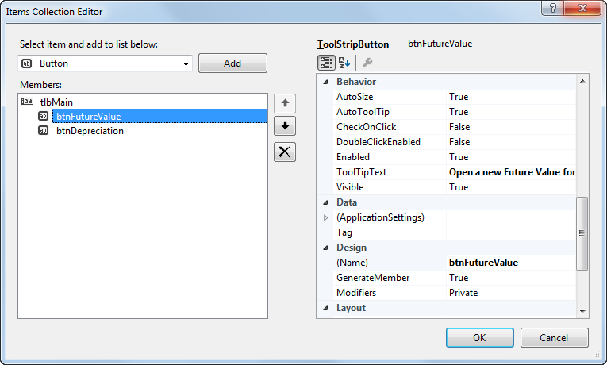
The Items Collection Editor dialog box for a ToolStrip

Slide 22
Code for the Click event of a button on a ToolStrip

Slide 23
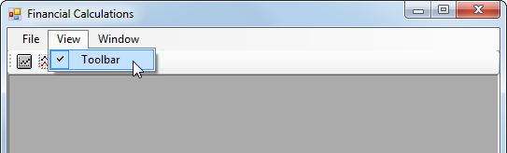
A View menu that shows or hides the toolbar

Slide 24
Code that shows or hides a toolbar depending on a menu selection

Slide 25
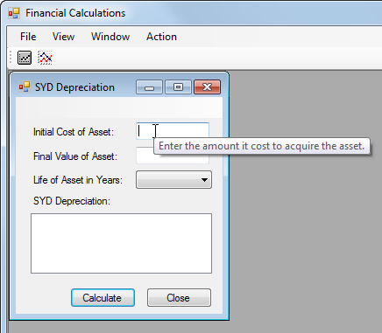
A tool tip

Slide 26
How to work with a tool tip

Slide 27
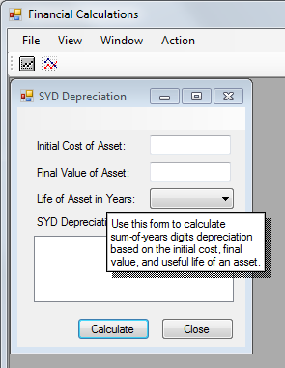
Context-sensitive help

Slide 28
How to work with context-sensitive help

Slide 29
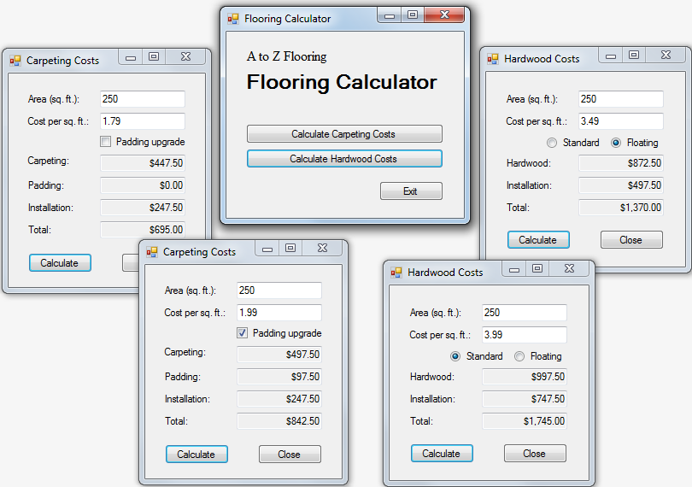
Extra 25-1 Create an SDI application

Slide 30
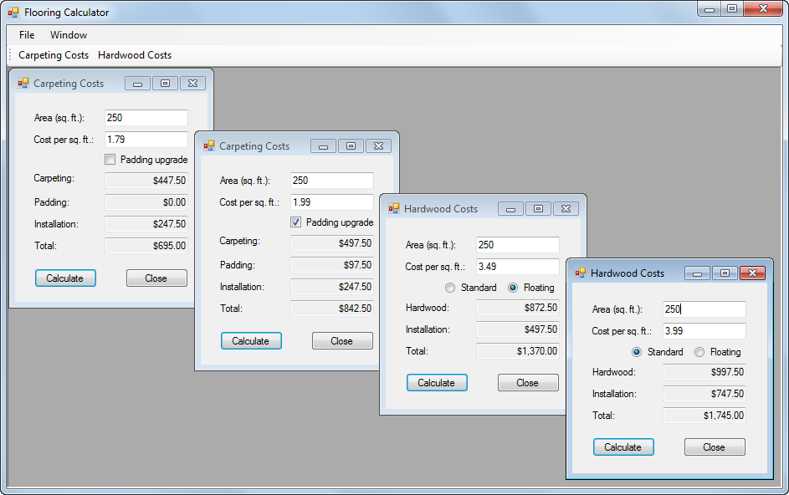
Extra 25-2 Create an MDI application

Slide 31
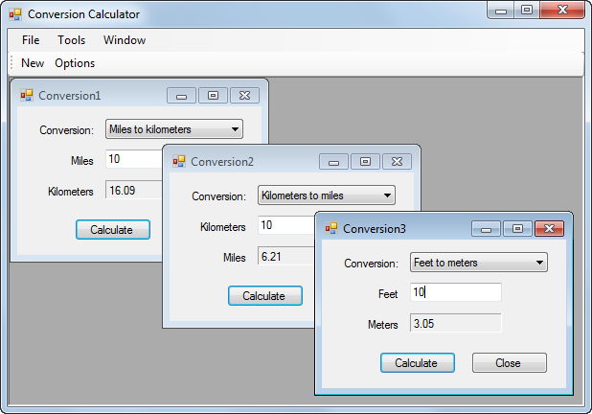
Project 6-1 Calculate conversions

Slide 32
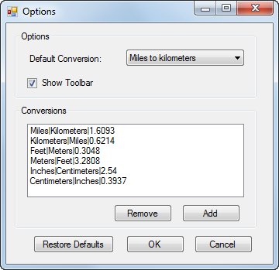
Project 6-1 Calculate conversions (cont.)

Slide 33
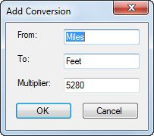
Project 6-1 Calculate conversions (cont.)

